Slide 1
Systems Analysis and Design
Course Code: CSE 305
Spring 2022 Semester
Instructor:
Shammi akhtar
Asst. Prof. CSE Dept., UAP

Slide 2
Project Management
An interrelated set of activities with definite starting and ending points, which results in a unique outcome for a specific allocation of resources.
Steps in planning projects –
Define work breakdown structure (statement of all work that has to be completed)
Diagram the network
Develop the schedule
Analyze cost-time trade-off
Assert risks

Slide 3
NETWORK ANALYSIS
It is a technique for planning and controlling large projects, such as construction work, R&D projects, computerization of systems etc. Its primary aim is to program and monitor the progress of a project so that the project is completed in the minimum time. In doing this, it pinpoints the parts of the project which are “crucial”.It can also be used in allocating resources such as labour and equipment and thus helps to make the total cost of a project minimum.

Slide 4
CPM AND PERT
Network analysis is operated in various forms under different titles, which include:
Critical Path Analysis (CPA) or
Critical Path Method (CPM);
(Deterministic)
Project Evaluation and Review Technique (PERT) (Probabilistic)

Slide 5
PERT
PERT: Program Evaluation Review Technique
Technique that uses optimistic (o), pessimistic (p), and realistic (r) time estimates to determine expected task duration
Formula for Estimated Time:
  ET = (o + 4r + p)/6

Slide 6
Drawing the network diagram
Estimate the time needed to complete each individual activity or task that makes up a part of the project
Sort out what activities must be done one after another, and which can be done at the same time, if required
Represent these in a network diagram

Slide 7
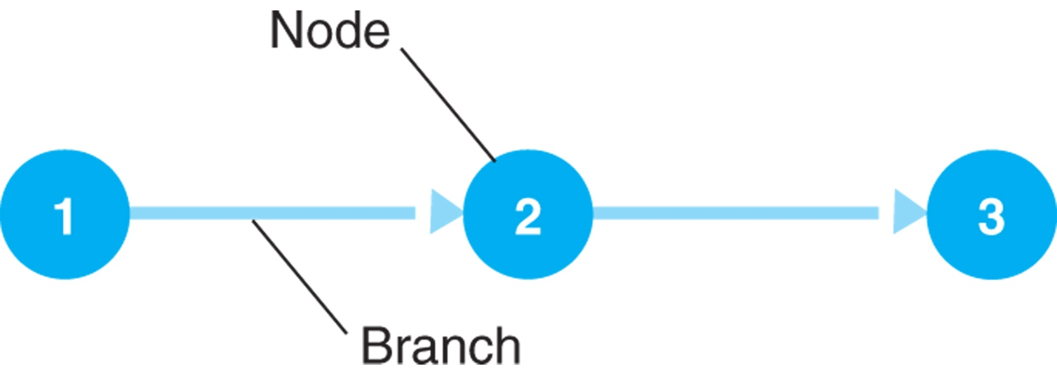
The Project Network - CPM/PERT
Activity-on-Arc (AOA) Network
A branch reflects an activity of a project.
A node represents the beginning and end of activities, referred to as events.
Branches in the network indicate precedence relationships.
When an activity is completed at a node, it has been realized.

Slide 8
The Project Network
House Building Project Data
Number | Activity | Predecessor | Duration
1 | Design house and obtain financing | -- | 3 months
2 | Lay foundation | 1 | 2 months
3 | Order and receive materials | 1 | 1 month
4 | Build house | 2,3 | 3 months
5 | Select paint | 2, 3 | 1 month
6 | Select carper | 5 | 1 month
7 | Finish work | 4, 6 | 1 month

Slide 9
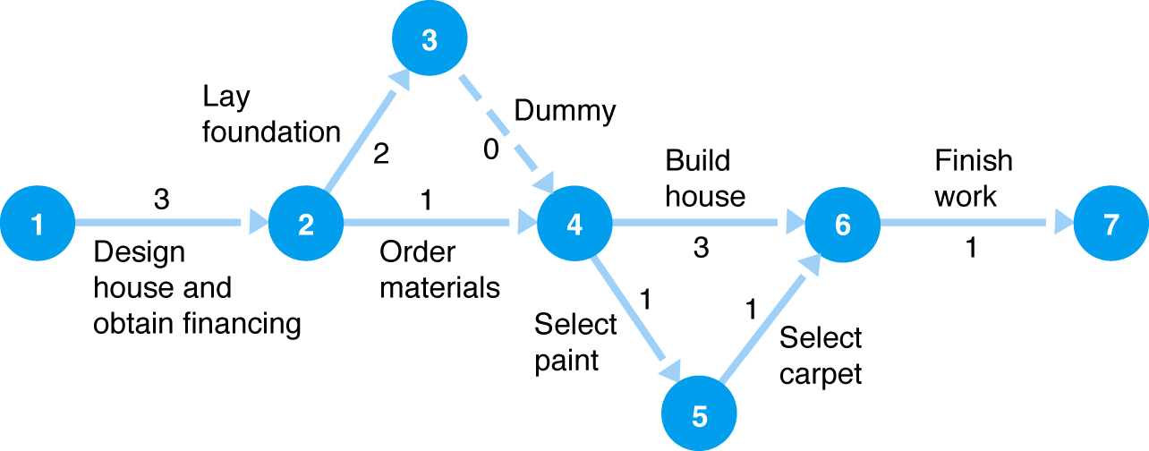
The Project Network
Concurrent Activities
Activities can occur at the same time (concurrently).
Network aids in planning and scheduling.
Time duration of activities shown on branches.
Figure: Concurrent activities for house-building project

Slide 10
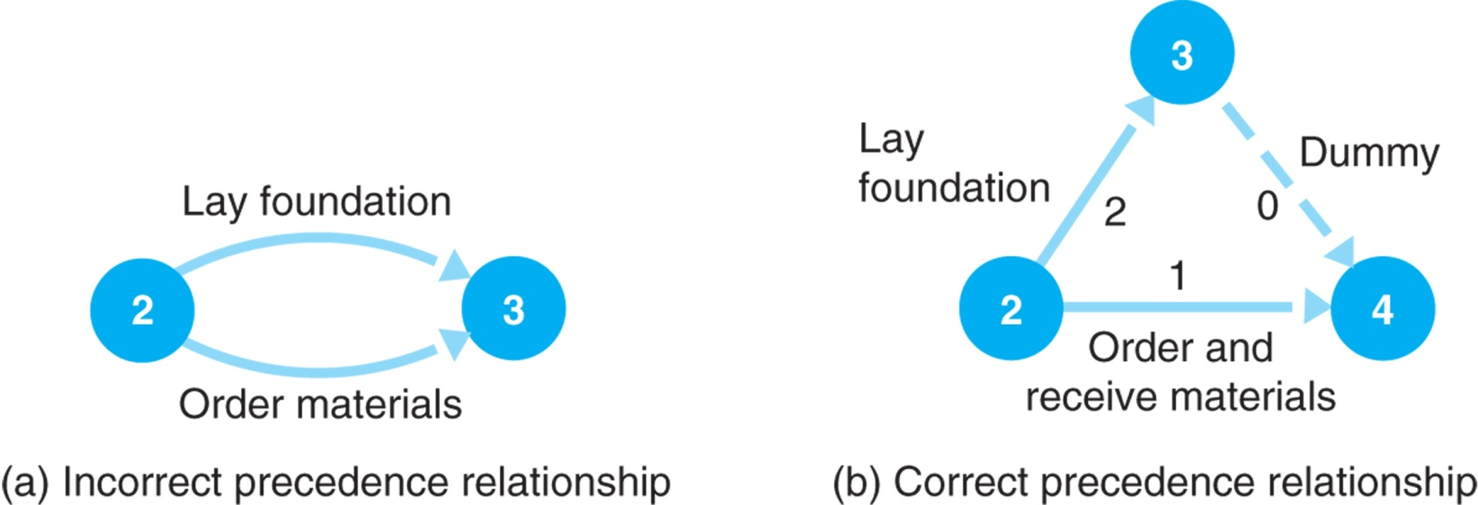
The Project Network
Dummy Activities
A dummy activity shows a precedence relationship but reflects no passage of time.
Two or more activities cannot share the same start and end nodes.
Figure: A dummy activity

Slide 11
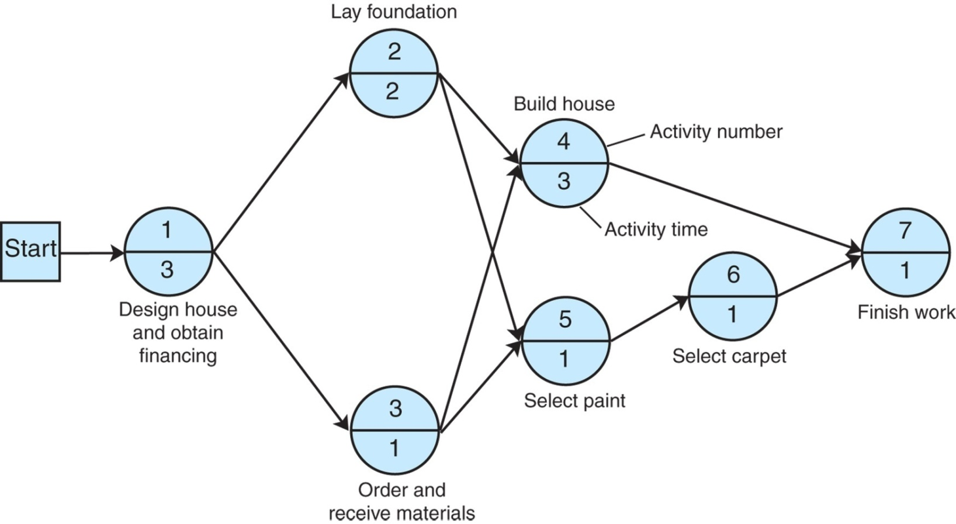
The Project Network
AON Network for House Building Project
Activity-on-Node (AON) Network
A node represents an activity, with its label and time shown on
the node
The branches show the precedence relationships
Figure: AON network

Slide 12
The Project Network
Paths Through a Network
Path | Events
A | 1→2→4→7
B | 1→2→5→6→7
C | 1→3→4→7
D | 1→3→5→6→7
Table:
Paths through the house-building network

Slide 13
The Project Network
The Critical Path
The critical path is the longest path through the network; the minimum time the network can be completed. From Figure :
Path A: 1 → 2 → 4 → 7 3 + 2 + 3 + 1 = 9 months
Path B: 1 → 2 → 5 → 6 → 7 3 + 2 + 1 + 1 + 1= 8 months
Path C: 1 → 3 → 4 → 7 3 + 1 + 3 + 1 = 8 months
Path D: 1 → 3 → 5 → 6 → 7 3 + 1 + 1 + 1 + 1 = 7 months

Slide 14
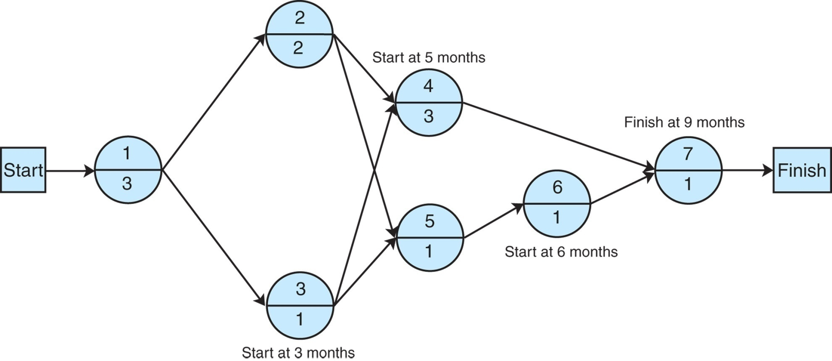
The Project Network
Activity Start Times
Figure: Activity start time

Slide 15
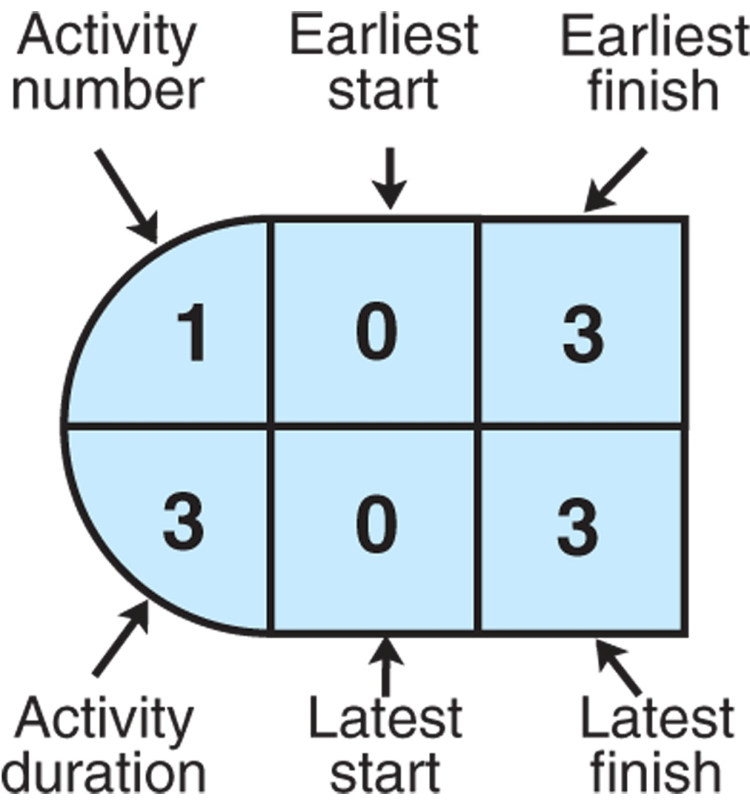
The Project Network
Activity Scheduling in Activity-on-Node Configuration
Figure: Activity-on-node configuration

Slide 16
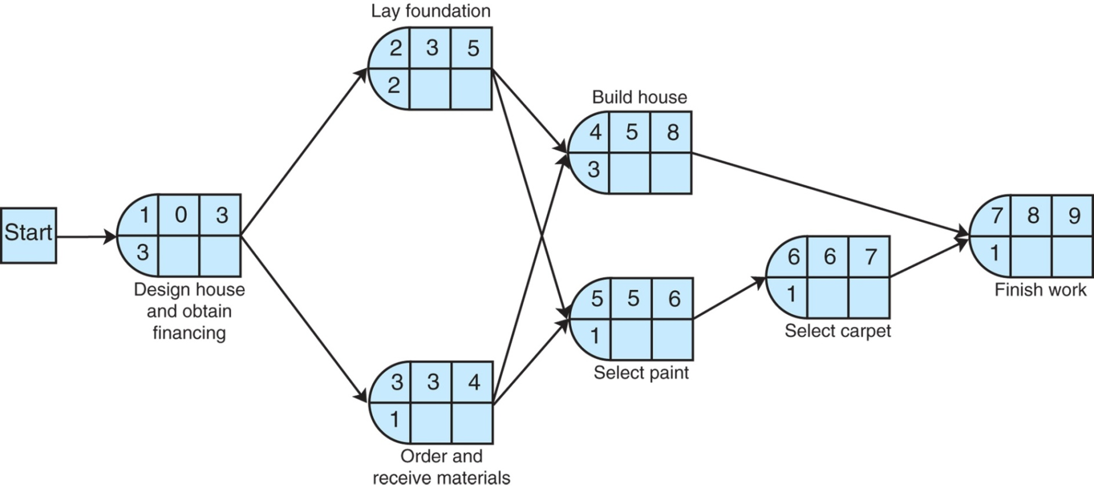

The Project Network
Activity Scheduling : Earliest Times
ES is the earliest time an activity can start:
EF is the earliest start time plus the activity time:
Figure: Earliest activity start and finish times

Slide 17

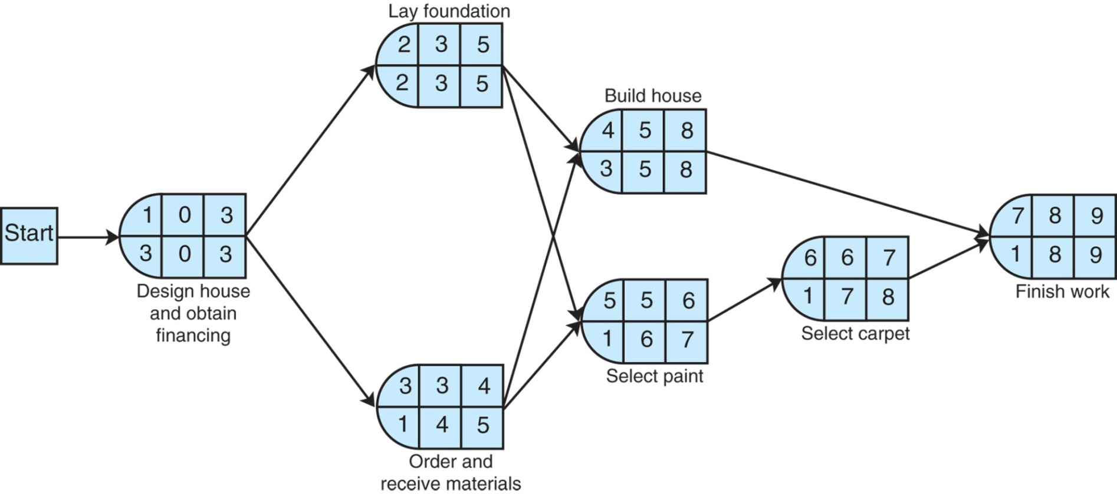
The Project Network
Activity Scheduling : Latest Times
LS is the latest time an activity can start without delaying critical path time:
Figure: Latest activity start and finish times
LF is the latest finish time:

Slide 18
The Project Network
Activity Slack Time (1 of 2)
Slack is the amount of time an activity can be delayed without delaying the project: S = LS – ES = LF - EF
Slack Time exists for those activities not on the critical path for which the earliest and latest start times are not equal.
Activity | LS | ES | LF | EF | Slack, S
*1 | 0 | 0 | 3 | 3 | 0
*2 | 3 | 3 | 5 | 5 | 0
3 | 4 | 3 | 5 | 4 | 1
*4 | 5 | 5 | 8 | 8 | 0
5 | 6 | 5 | 7 | 6 | 1
6 | 7 | 6 | 8 | 7 | 1
*7 | 8 | 8 | 9 | 9 | 0
*Critical path

Slide 19
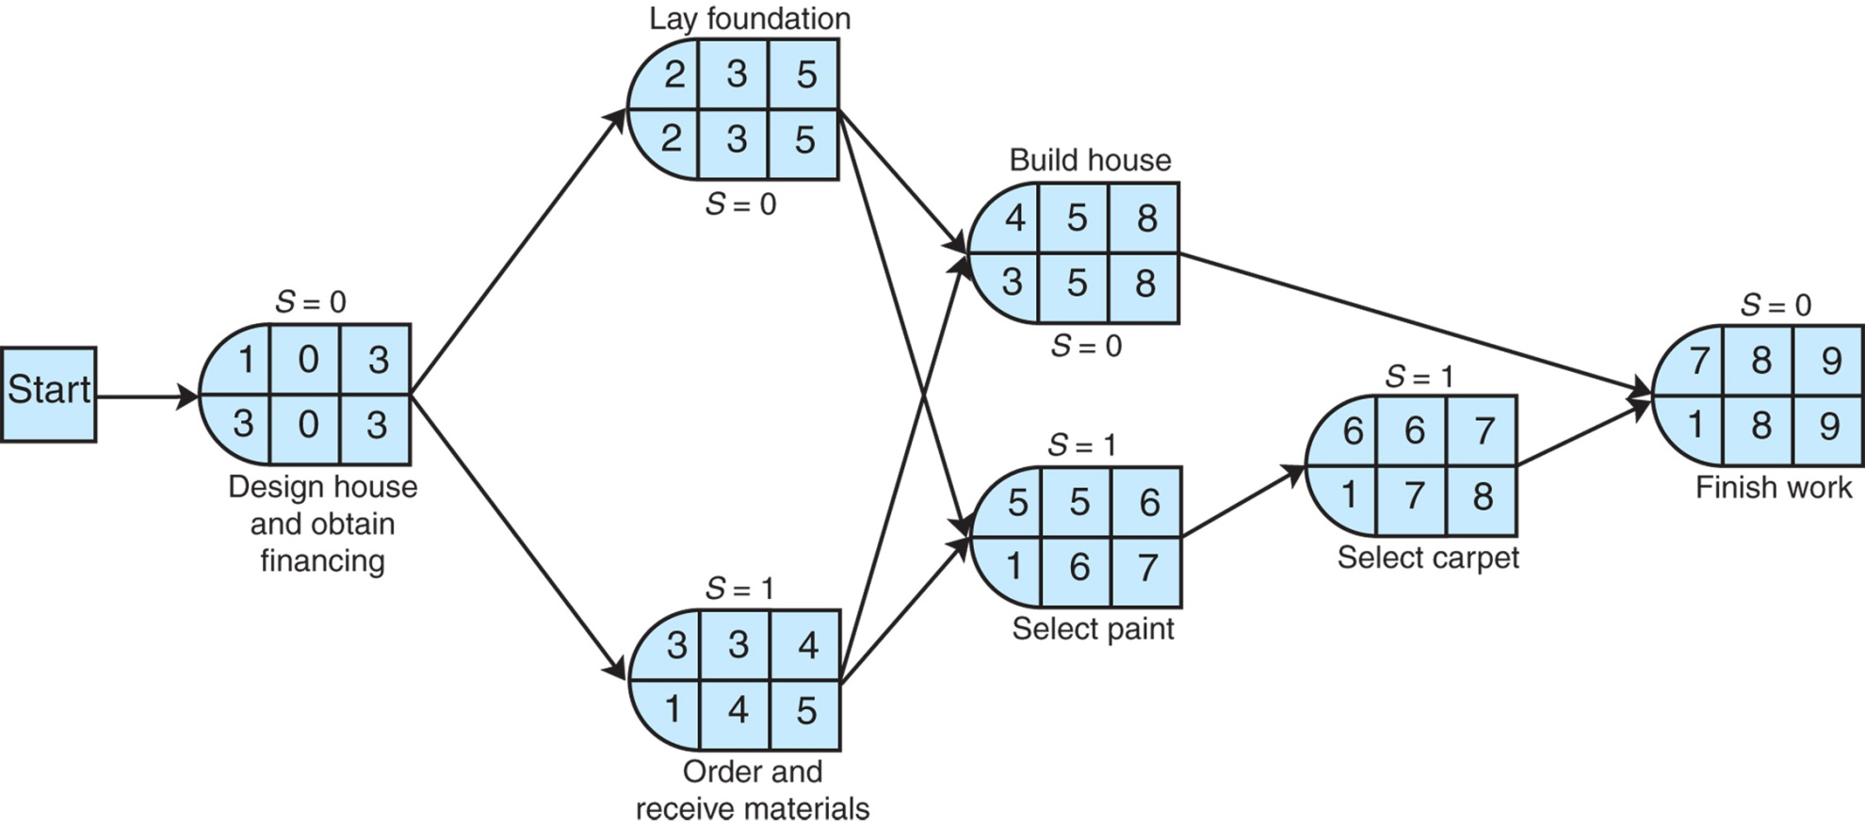
The Project Network
Activity Slack Time (2 of 2)
Figure: Activity slack

Slide 20
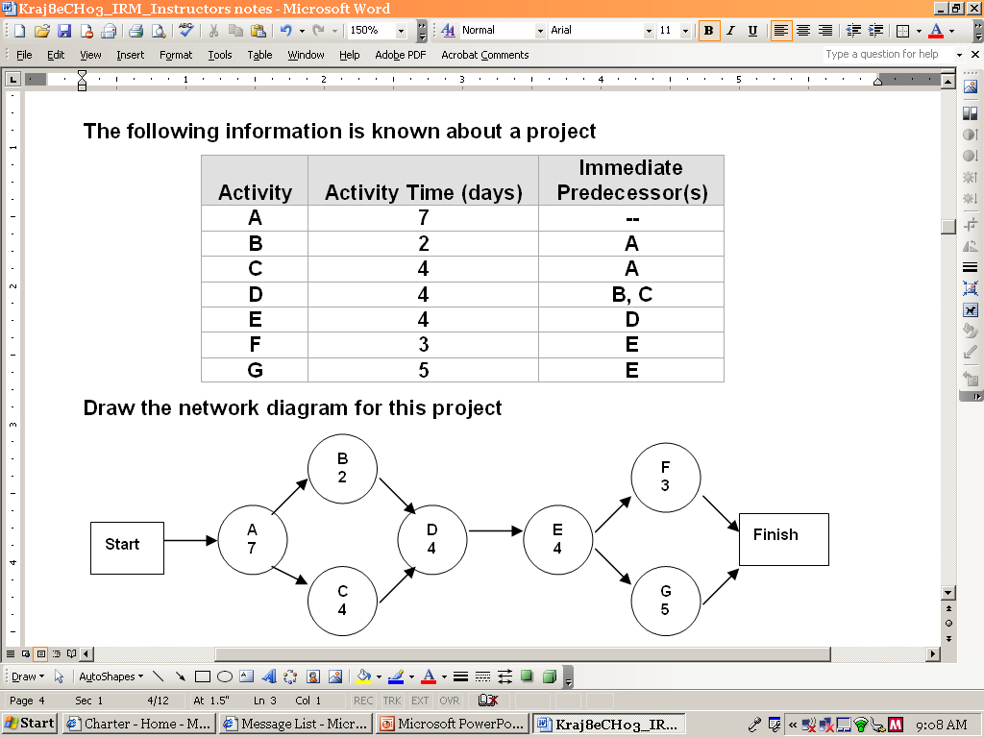
Example 2
Draw the AON network for this project.
What is the Critical Path and Project Duration?

Slide 21
Example 2 - Solution

Slide 22
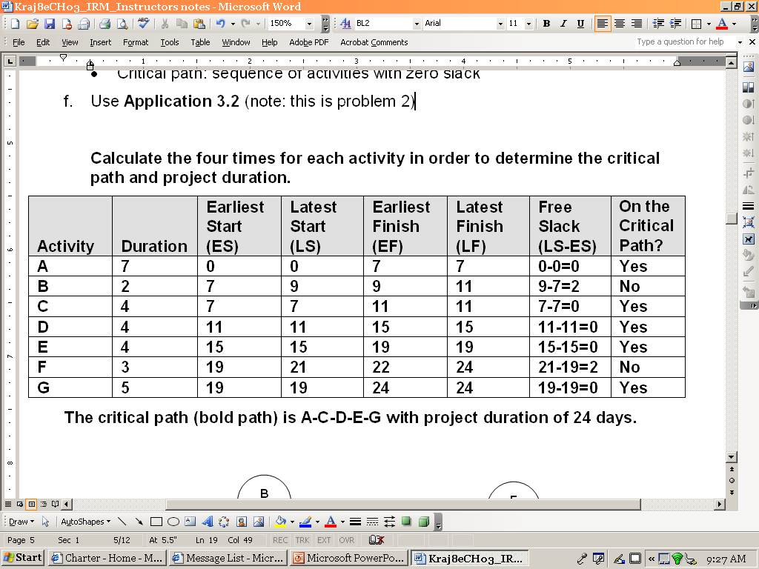
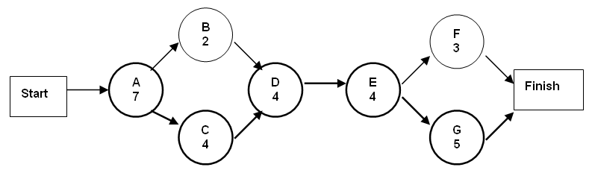
Problem 2 - Critical Path and Project Duration

Slide 23
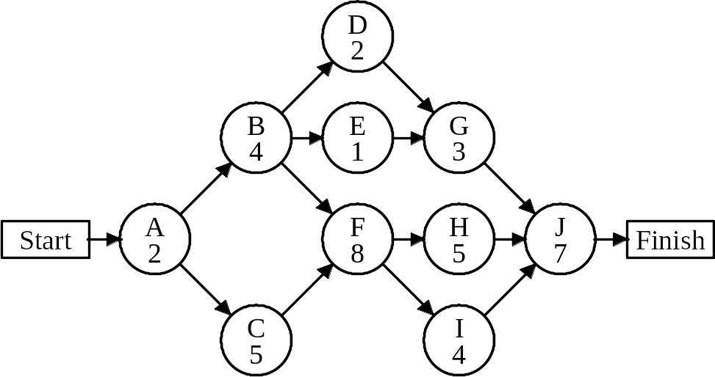
Problem 3 – Consider the following project network.
Determine the critical path and the project duration.

Slide 24
Problem 3 – Solution:
The critical path is A–C–F–H–J with a completion time
of 27 days.
 |  |  |  | Earliest | Latest | Earliest | Latest | Total | On Critical
 |  | Activity | Duration | Start | Start | Finish | Finish | Slack | Path?
 |  | A | 2 | 0 | 0 | 2 | 2 | 0 | Yes
 |  | B | 4 | 2 | 3 | 6 | 7 | 1 | No
 |  | C | 5 | 2 | 2 | 7 | 7 | 0 | Yes
 |  | D | 2 | 6 | 15 | 8 | 17 | 9 | No
 |  | E | 1 | 6 | 16 | 7 | 17 | 10 | No
 |  | F | 8 | 7 | 7 | 15 | 15 | 0 | Yes
 |  | G | 3 | 8 | 17 | 11 | 20 | 9 | No
 |  | H | 5 | 15 | 15 | 20 | 20 | 0 | Yes
 |  | I | 4 | 15 | 16 | 19 | 20 | 1 | No
 |  | J | 7 | 20 | 20 | 27 | 27 | 0 | Yes

Slide 25
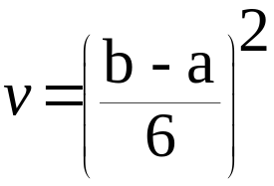
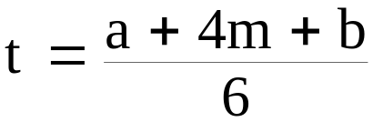
Probabilistic Activity Times
Activity time estimates usually cannot be made with certainty.
PERT used for probabilistic activity times.
In PERT, three time estimates are used: most likely time (m), the optimistic time (a), and the pessimistic time (b); using Beta Distribution.
These provide an estimate of the mean and variance of a beta distribution:
variance:
mean (expected time):

Slide 26
Probabilistic Activity Times
PERT: Program Evaluation Review Technique
Technique that uses optimistic (o), pessimistic (p), and realistic (r) time estimates to determine expected task duration
Formula for Estimated Time:
  ET = (o + 4r + p)/6

Slide 27
Probabilistic
Time Estimates
Beta Distribution
Probability
a
m
b
Time
Optimistic
Mean
Pessimistic
Notes:
72

Slide 28
Probabilistic Activity Times
Another Example
To demonstrate the use of probabilistic activity times, we will employ a new example. (We could use the house-building network from the previous section; however, a network that is a little larger and more
complex will provide more experience with different types of projects.)

Slide 29
Probabilistic Activity Times - Another Example
The Southern Textile Company has decided to install a new computerized order processing system that will link the company with customers and suppliers online. In the past, orders for the cloth the company produces were processed manually, which contributed to delays in delivering orders and resulted in lost sales. The company wants to know how long it will take to install the new system.
We will briefly describe the activities and the network for the installation of the new order processing system.

Slide 30
The Southern Textile Company - Activities
The network begins with three concurrent activities: The new computer equipment is installed (activity 1); the computerized order processing system is developed (activity 2); and people are recruited to operate the system (activity 3). Once people are hired, they are trained for the job (activity 6), and other personnel in the company, such as marketing, accounting, and production personnel, are introduced to the new system (activity 7). Once the system is developed (activity 2), it is tested manually to make sure that it is logical (activity 5). Following activity 1, the new equipment is tested, and any necessary modifications are made (activity 4), and the newly trained personnel begin training on the computerized system (activity 8). Also, node 9 begins the testing of the system on the computer to check for errors (activity 9). The final activities include a trial run and changeover to the system (activity 11) and final debugging of the computer system (activity 10).

Slide 31
Precedence relations and Activity Times– Textile Company
Task a m b Preceding Tasks
Task 1 6 8 10
Task 2 3 6 9
Task 3 1 3 5
Task 4 2 4 12 Task 1
Task 5 2 3 4 Task 2
Task 6 3 4 5 Task 3
Task 7 2 2 2 Task 3
Task 8 3 7 11 Task 1 Task 5 Task 6
Task 9 2 4 6 Task 1 Task 5 Task 6
Task 10 1 4 7 Task 4
Task 11 1 10 13 Task 7 Task 8 Task 9

Slide 32
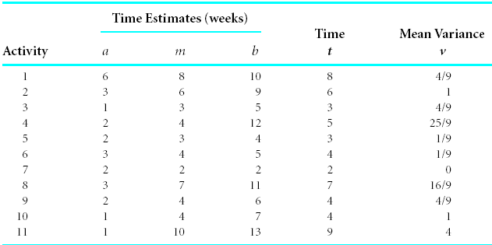
Probabilistic Activity Times
The Southern Textile Company
Activity time estimates for figure

Slide 33
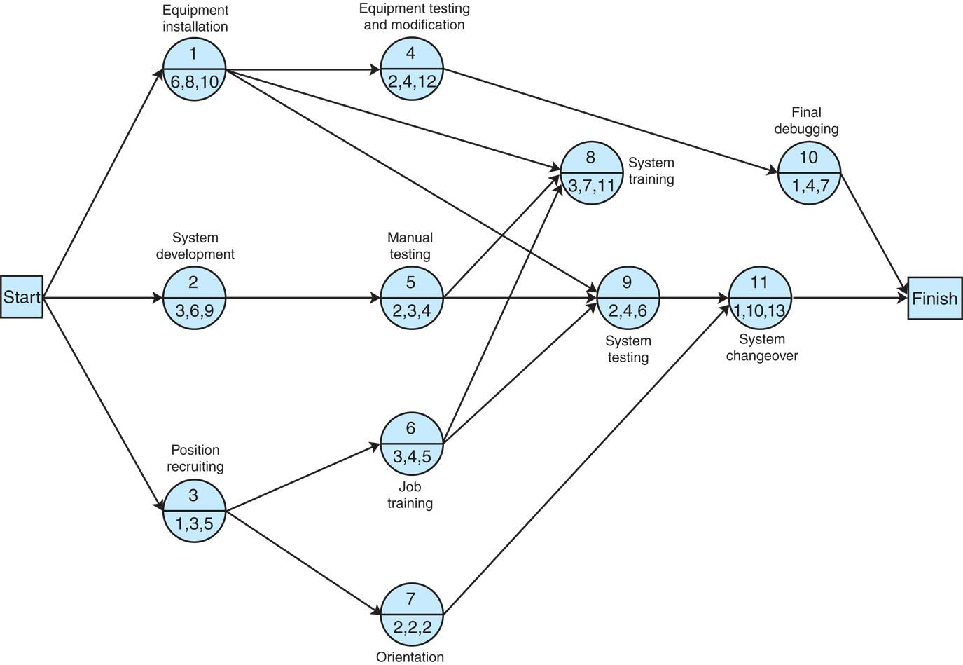
Probabilistic Activity Times
The Southern Textile Company
Network for order processing system installation

Slide 34
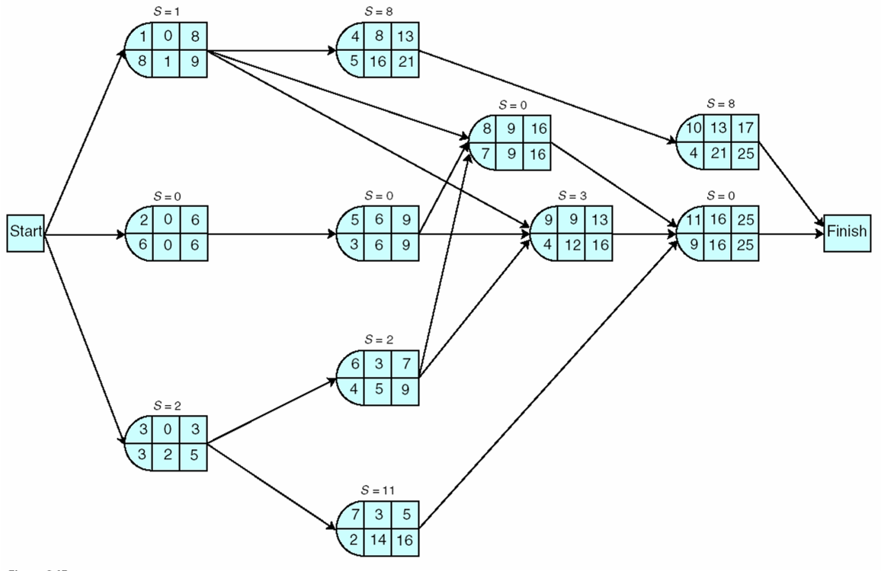
Probabilistic Activity Times
The Southern Textile Company
Earliest and latest activity times

Slide 35
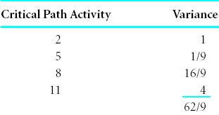
Probabilistic Activity Times
Expected Project Time and Variance
Expected project time is the sum of the expected times of the critical path activities.
Project variance is the sum of the critical path activities’ variances
The expected project time is assumed to be normally distributed (based on central limit theorem).
In example, expected project time (t_{p}) and variance (v_{p}) interpreted as the mean (μ) and variance (σ²) of a normal distribution:
= 25 weeks
σ² = 62/9
= 6.9 weeks²

Slide 36
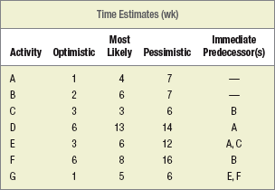
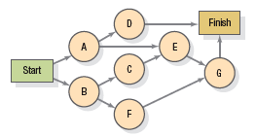
Solved Problem 2
What is the probability of completing the project in 23 weeks?

Slide 37
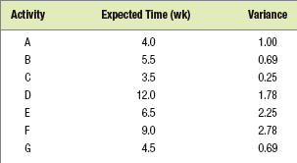
Solved Problem 2

Slide 38
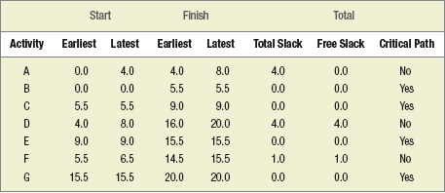
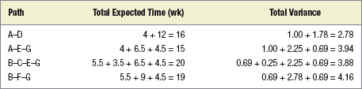

Solved Problem 2
Using the Normal Distribution, we find that the probability of completing the project in 23 weeks or less is 0.9357.
Notes:
70

Slide 39
PERT Example
PERT: Program Evaluation Review Technique
Technique that uses optimistic (o), pessimistic (p), and realistic (r) time estimates to determine expected task duration
Formula for Estimated Time:
  ET = (o + 4r + p)/6

Slide 40
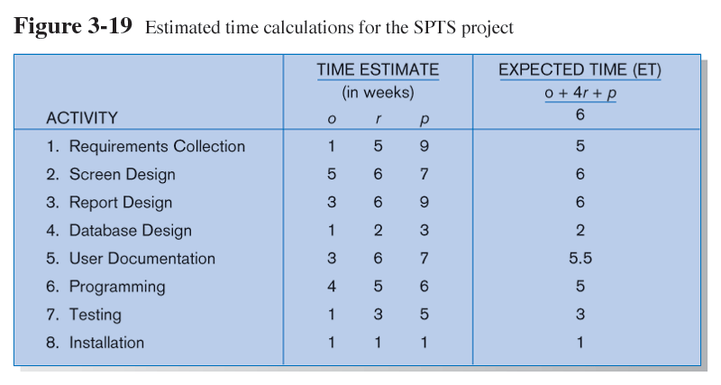
Example PERT Analysis

Slide 41
Critical Path Scheduling
A scheduling technique whose order and duration of a sequence of task activities directly affects the completion date of a project
Critical path: the shortest time in which a project can be completed
Slack time: the time an activity can be delayed without delaying the project

Slide 42
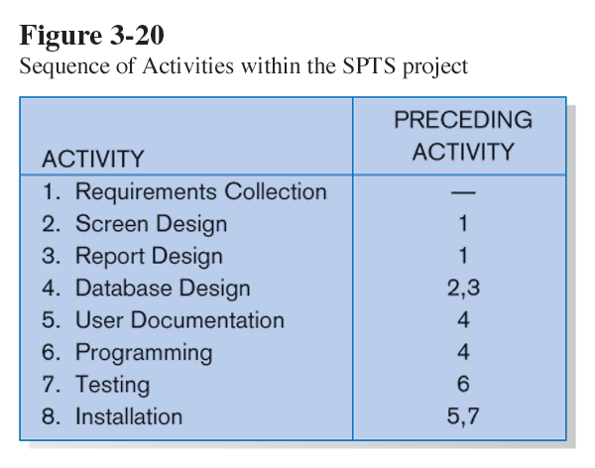
Critical Path Example
(dependencies between tasks)
PRECEDING ACTIVITIES indicate the activities that must be completed before the specified activity can begin (see Fig. 3.19 for time estimates).

Slide 43
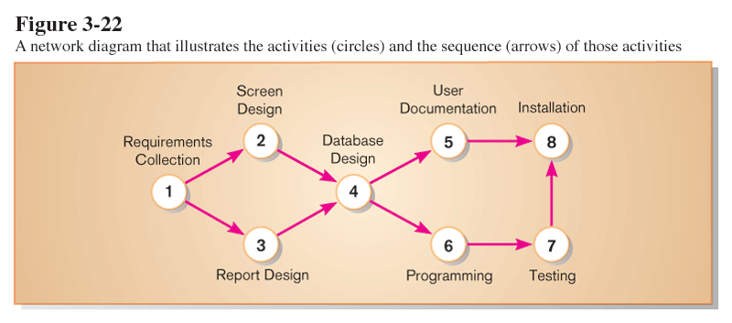
Critical Path Example
Network diagram shows dependencies
Network diagram provides graphical illustration of dependencies between activities (see previous slide).

Slide 44
Determining the Critical Path
Calculate the earliest possible completion time for each activity by summing the activity times in the longest path to the activity. This gives total expected project time.
Calculate the latest possible completion time for each activity by subtracting the activity times in the path following the activity from the total expected time. This gives slack time for activities.
Critical path – contains no activities with slack time.

Slide 45
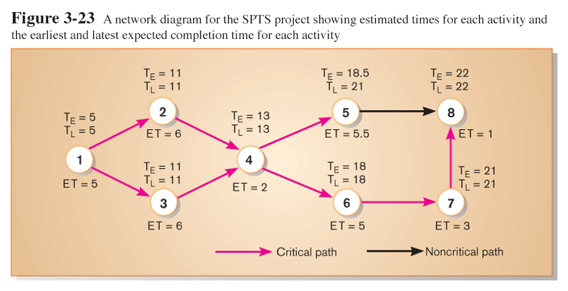
Critical Path Calculation
Early and late time calculations are determined and critical path established. (Note: Activity #5 can begin late without affecting project completion time).

Slide 46
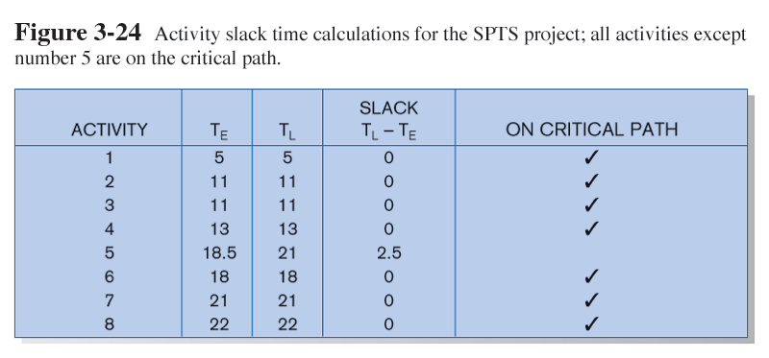
Critical Path Calculation (cont.)
Note the slack time in Activity #5.

